Slide 1
Biol 7200: Programming for Bioinformatics Exercise 2 demos

Slide 2
Demo plan
Demos/discussion
Broken code

Slide 3
New structure this week for scripts
We’ll demo 2 scripts this week
change_headers.sh
perfect_hits.sh
Volunteers will be picked now
Email me your script (biol7200.gt@gmail.com)
I’ll run it and show it (if it fails another volunteer will be selected)
You walk us through it

Slide 4
View wizard
What is the difference between using single vs double quotes when defining an alias?

Slide 5
View wizard - explanation
What is the difference between using single vs double quotes when defining an alias?
Double quote:
Variable substitution performed at creation of alias; variable value stored in alias
Alias no longer linked to variable
Changes to variable not reflected in alias
Single quotes
Variable substitution performed at execution of alias; variable name stored in alias
Alias remains linked to variable
Changes to variable reflected in alias

Slide 6
Change_headers.sh
Nobody offered a solution that used only concepts covered so far. However, several people did offer good solutions.
I have included a couple of examples here which I encourage you to review after next week’s material.
Consider the differences in syntax of the different approaches, but also think about the difference it would make to the processing of the data. Is one approach more or less flexible? Is one more readable to someone who hasn’t seen the code before?
I have added some comments. My comments begin “AC”

Slide 7
Process substitution approach
#!/bin/bash
#Input and output file names
input_file="$1"
output_file="$2"
#Process the input file
accession=$(basename "$input_file" | cut -d. -f1) # AC: basename is a good tool here in case the input file is not in your current directory
sed "s/>/>$accession/g" $input_file > $output_file # AC: How could you add “_” after $accession here?

Slide 8
Parameter expansion approach
#!/bin/bash
filename="$1"
delimiter=">" #character searching for
#gets rid of everything at and after the '.'
additional_header="${filename%.*} " # AC: how could you also replicate the behaviour of ‘basename’ using this approach?
#s stands for substitute, g stands for global, meaning all occurences of
sed "s/$delimiter/$delimiter$additional_header /g" "$filename" > "$2“
# AC: This example is well commented and uses variable names that are somewhat “self-documenting” (meaning the variable names make clear what the code is doing)
# AC: when is g (global mode) required in sed? Is it required here? Is there any downside to using it when not needed?

Slide 9
Change_headers.sh: my solution using covered material
#!/usr/bin/bash
# usage: change_headers.sh <input file> <output file>
sed -e "s/>/>$1_/" -e 's/.fna//' $1 > $2 # AC: what if the extension is not .fna? Is there a way to use this approach if you aren’t sure which fasta extension will be used?
# AC: Is it clearer doing it in one line like this or breaking it up into steps like the student solutions? Which would be easier to troubleshoot if something wasn’t working right?

Slide 10
find_perfect_matches.sh
#!/usr/bin/bash
blastn -query $1 -subject $2 -task blastn-short -outfmt '6 std qlen'| awk '$3==100.000 && $5==0 && $10-$9+1==$13' >> $3
wc -l $3
# AC: Note, as said during the demo, $5==0 (mismatches) is redundant with $3==100 (percent sequence identity)
# AC: $10-$9+1 is the difference between end and start position of match in subject.
# AC: That is the same as $4 (match length)

Slide 11
find_perfect_matches.sh: my solution
#!/usr/bin/bash
# usage: find_perfect_matches.sh <query file> <subjectfile> <output file>
blastn -query $1 -subject $2 -outfmt '6 std qlen' -task blastn-short | awk '$3==100 && $4==$13' > $3
wc -l $3
Columns in output:
1 2 3 4 5 6 7 8 9 10 11 12 13
qseqid sseqid pident length mismatch gapopen qstart qend sstart send evalue bitscore qlen

Slide 12
Broken code structure reminder
What’s it trying to do?
What’s wrong with it?
How would you fix it?

Slide 13
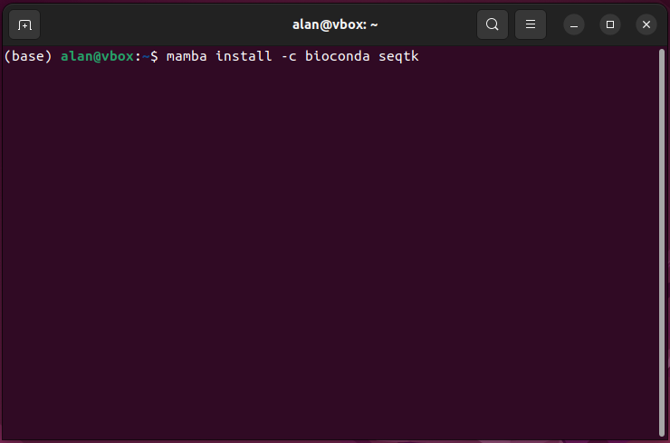
Broken code 1
What’s it trying to do?
What’s wrong with it?
How would you fix it?

Slide 14
Broken code 1
What’s it trying to do?
Install seqtk in base env
What’s wrong with it?
Almost nothing should be installed in base
How would you fix it?
Make a new environment instead

Slide 15
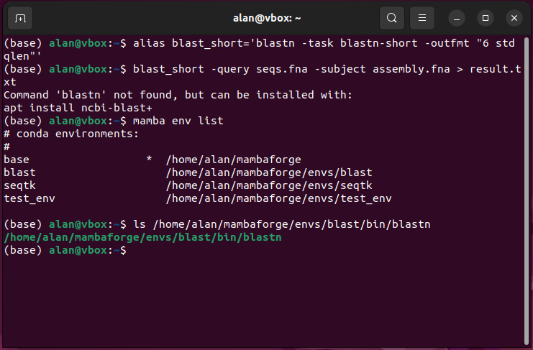
Broken code 2
What’s it trying to do?
What’s wrong with it?
How would you fix it?

Slide 16
Broken code 2
What’s it trying to do?
Run blastn using an alias
What’s wrong with it?
Blast isn’t installed in current env
How would you fix it?
Activate env with blast before running alias

Slide 17
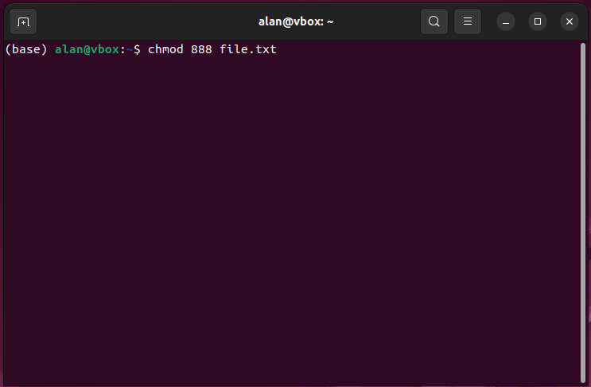
Broken code 3
What’s it trying to do?
What’s wrong with it?
How would you fix it?

Slide 18
Broken code 3
What’s it trying to do?
Change file permissions somehow
What’s wrong with it?
888 isn’t a valid octal mode (0-base counting)
How would you fix it?
Use the right numbers (0-7)

Slide 19
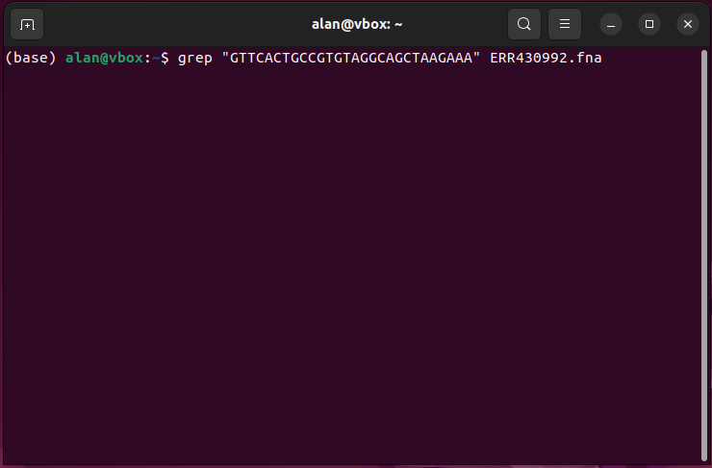
Broken code 4
What’s it trying to do?
What’s wrong with it?
How would you fix it?

Slide 20
Broken code 4
What’s it trying to do?
Identify CRISPR repeats in an assembly
What’s wrong with it?
Grep is the wrong tool – sequence might be split over lines in the file or reversed
How would you fix it?
Use BLAST or another specialized tool

Slide 21
Back to the lecture

